Slide 1
Ch-7 Diagrams
The static parts of a system using one of the four following diagrams.
1. Class diagram
2. Object diagram
3. Component diagram
4. Deployment diagram

Slide 2
Five additional diagrams to view the dynamic parts of a system.
1. Use case diagram
2. Sequence diagram
3. Collaboration diagram
4. Statechart diagram
5. Activity diagram
The UML defines these nine kinds of diagrams

Slide 3
Structural Diagrams
The UML's four structural diagrams exist to visualize, specify, construct, and document the static aspects of a system.
The static aspects of a system represents stable skeleton.

Slide 4
The UML's structural diagrams are roughly organized around the major groups of things you'll find when modeling a system.
1. Class diagram--- Classes, interfaces, and collaborations
2. Object diagram--- Objects
3. Component diagram---Components
4. Deployment diagram---Nodes

Slide 5
1.Class Diagram
A class diagram shows a set of classes, interfaces, and collaborations and their relationships.
Class diagrams are the most common diagram found in modeling object-oriented systems.
Class diagrams are used to illustrate the static design view of a system.
Class diagrams that include active classes are used to address the static process view of a system.

Slide 6
2. Object Diagram
An object diagram shows a set of objects and their relationships.
Object diagrams address the static design view or static process view of a system just as do class diagrams.

Slide 7
3. Component Diagram
A component diagram shows a set of components and their relationships.
Component diagrams are used to illustrate the static implementation view of a system.
Component diagrams are related to class diagrams in that a component typically maps to one or more classes, interfaces, or collaborations.

Slide 8
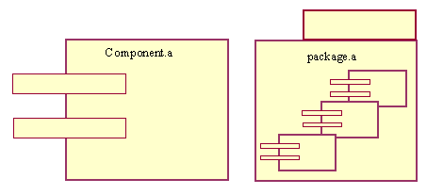
component diagram

Slide 9
4. Deployment Diagram
A deployment diagram shows a set of nodes and their relationships.
Deployment diagrams are used to illustrate the static deployment view of an architecture.
Deployment diagrams are related to component diagrams in that a node typically encloses one or more components.

Slide 10
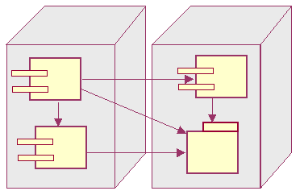
deployment diagram

Slide 11
Behavioral Diagrams
The UML's five behavioral diagrams are used to visualize, specify, construct, and document the dynamic aspects of a system.
You can think of the dynamic aspects of a system as representing its changing parts.
The dynamic aspects of a software system encompass things as the flow of messages over time and the physical movement of components across a network.

Slide 12
The UML's behavioral diagrams are roughly organized around the major ways you can model the dynamics of a system.
1. Use case diagram--- Organizes the behaviors of the system.
2. Sequence diagram ---Focused on the time ordering of messages.
3. Collaboration diagram---Focused on the structural organization of objects that send and receive messages.
4. Statechart diagram---Focused on the changing state of a system driven by events.
5. Activity diagram---Focused on the flow of control from activity to activity.

Slide 13
Use Case Diagram
A use case diagram shows a set of use cases and actors (a special kind of class) and their relationships.
Apply use case diagrams to illustrate the static use case view of a system.
Use case diagrams are especially important in organizing and modeling the behaviors of a system.

Slide 14
Interaction diagram
Interaction diagram is the collective name given to sequence diagrams and collaboration diagrams.

Slide 15
Sequence Diagram
A sequence diagram is an interaction diagram that emphasizes the time ordering of messages.
A sequence diagram shows a set of objects and the messages sent and received by those objects.
Use sequence diagrams to illustrate the dynamic view of a system.

Slide 16
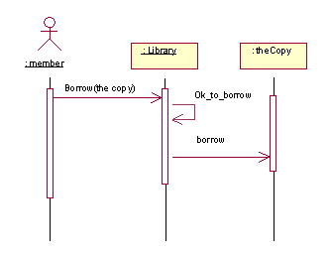
sequence diagram

Slide 17
Collaboration Diagram
A collaboration diagram is an interaction diagram that emphasizes the structural organization of the objects that send and receive messages.
A collaboration diagram shows a set of objects, links among those objects, and messages sent and received by those objects.
Use collaboration diagrams to illustrate the dynamic view of a system.

Slide 18
Statechart Diagram
A statechart diagram shows a state machine, consisting of states, transitions, events, and activities.
Use statechart diagrams to illustrate the dynamic view of a system.
Statechart diagrams emphasize the event-ordered behavior of an object, which is especially useful in modeling reactive systems.

Slide 19
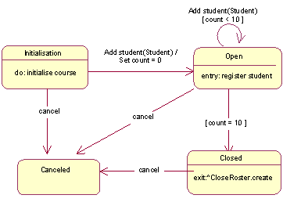
statechart diagram

Slide 20
Activity Diagram
An activity diagram shows the flow from activity to activity within a system.
An activity shows a set of activities, the sequential or branching flow from activity to activity.
Use activity diagrams to illustrate the dynamic view of a system.
Activity diagrams emphasize the flow of control among objects.

